Slide 1

MIS 281N
Data Management
Class 6 – Information and Data Security
Clint Tuttle
Senior Lecturer, The University of Texas at Austin
Brad Poynter
Lecturer, The University of Texas at Austin

Slide 2
Objectives
Five Functions of the NIST Cybersecurity Framework
Information Security Case Discussion
Authentication
Authorization
Questions and Discussion

Slide 3
Questions? Takeaways, Reflections

Slide 4
NIST Five Functions of Cybersecurity
Identify
Inventory, Categorize, Plan
Protect
Authenticate, Authorize, Patch, Test, Mask, Encrypt
Detect
Monitor, Log, Alert
Respond
Communicate, Incident Mgmt, Coordinate, Process Improve
Recover
Backup/Restore, Continuity

Slide 5
Case Discussion

Slide 6
Instructions
Discuss the questions outlined in “Information Security Discussion” on Canvas amongst yourselves.
10 min
Prepare a 3 minute presentation that captures your discussion
10 min
Appoint a spokesperson for your team
Present

Slide 7
Database Authentication

Slide 8
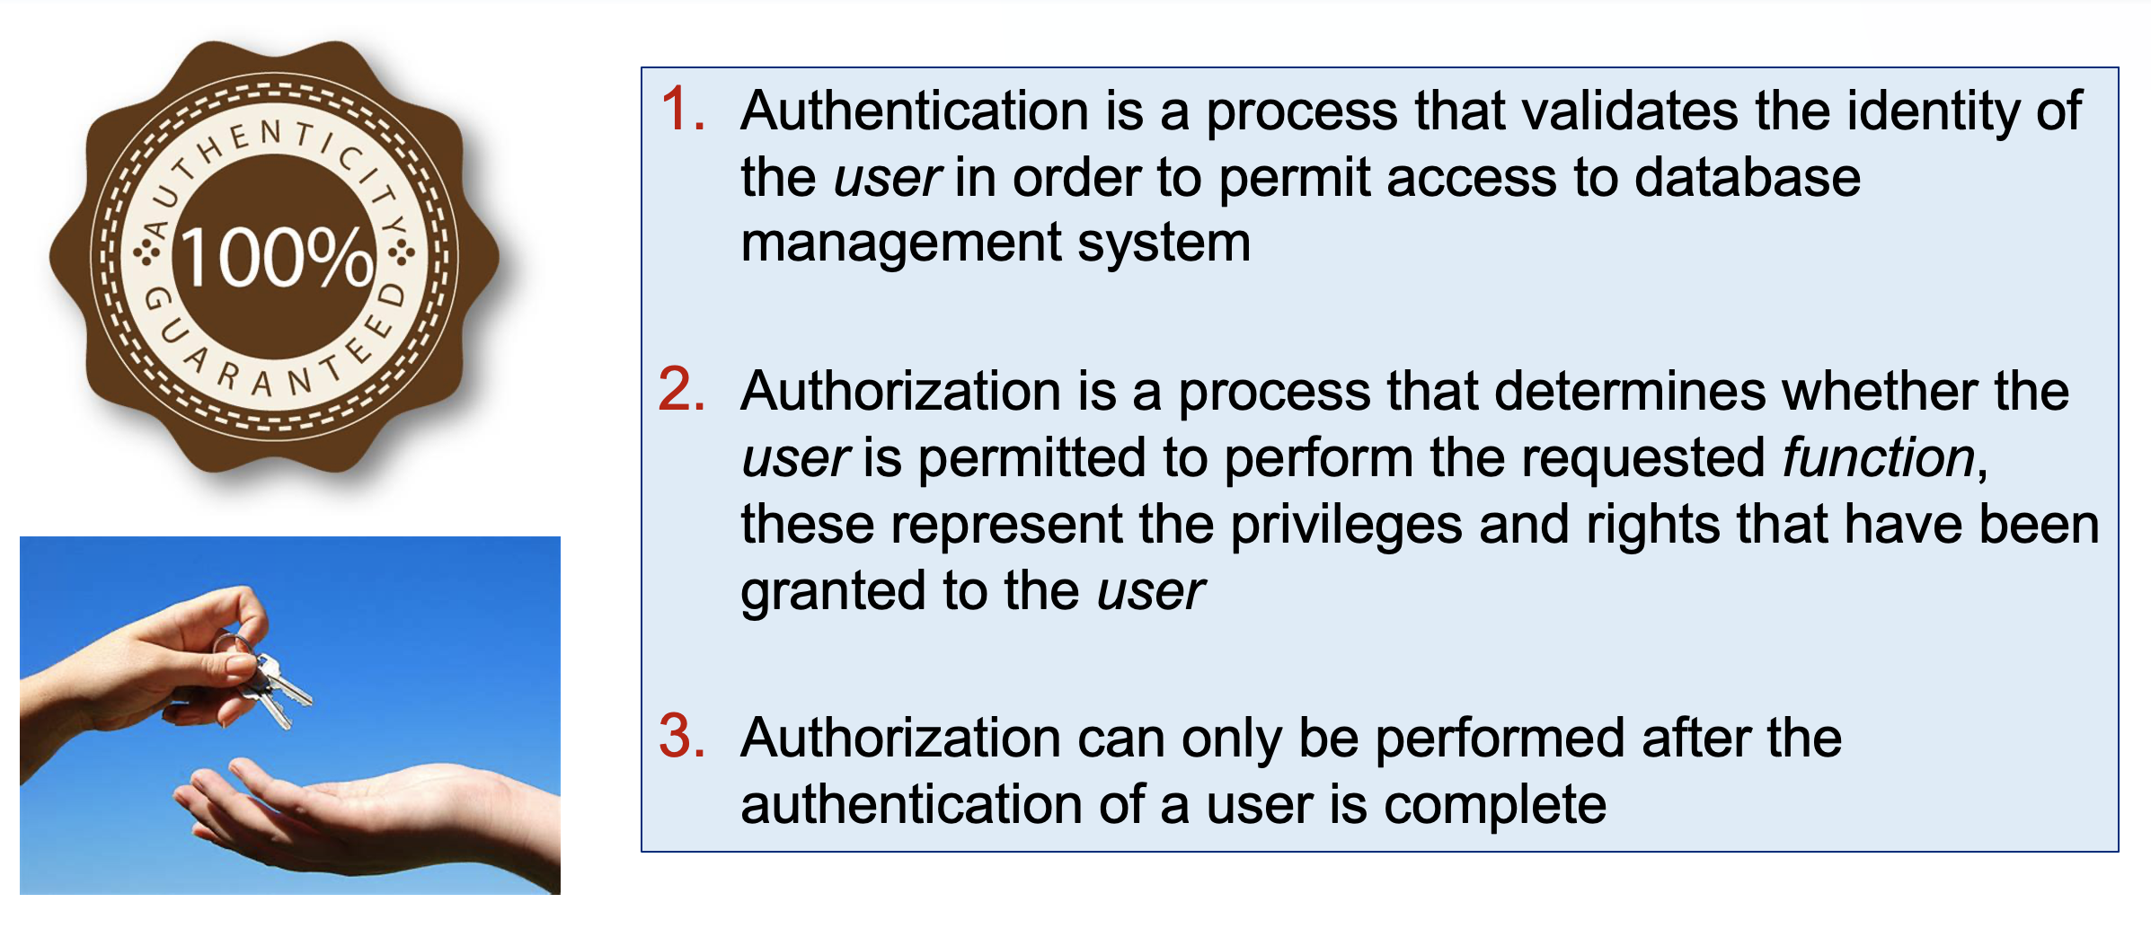
Authentication vs Authorization

Slide 9
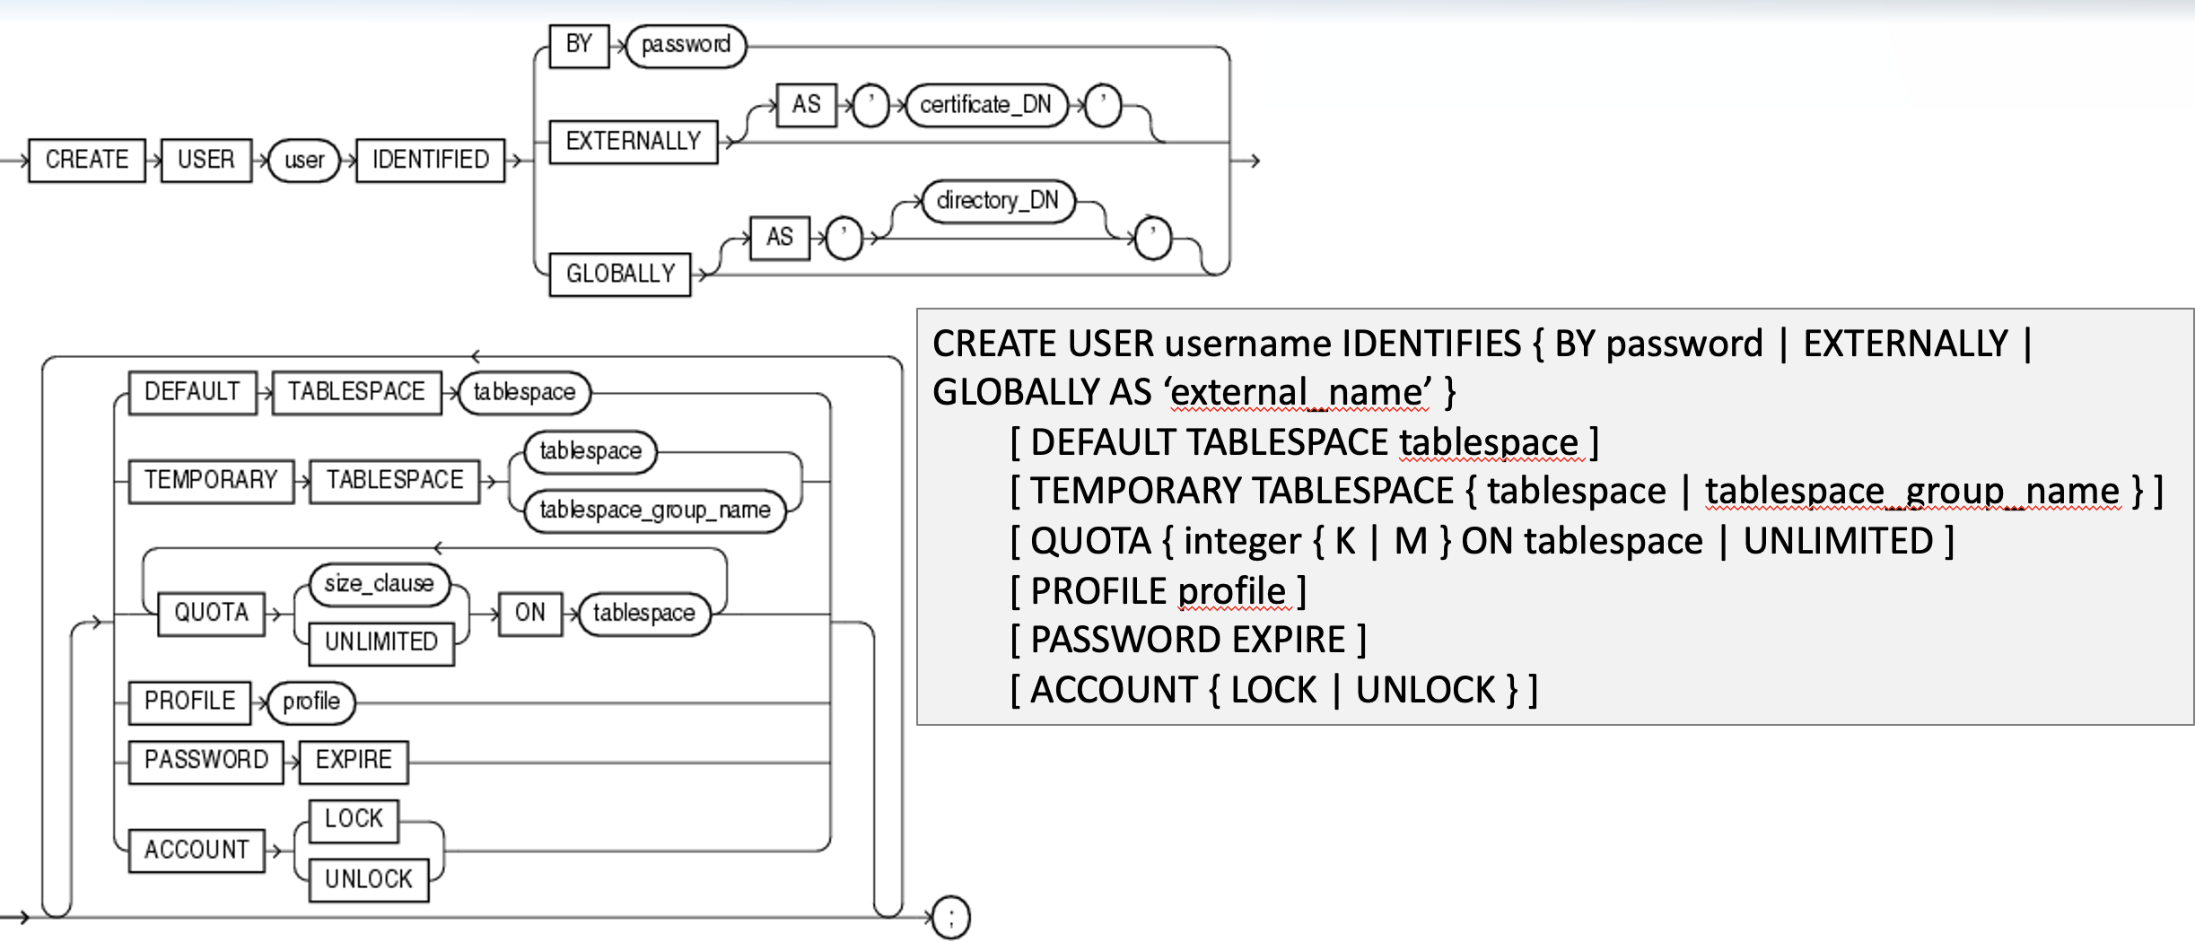
Create User

Slide 10
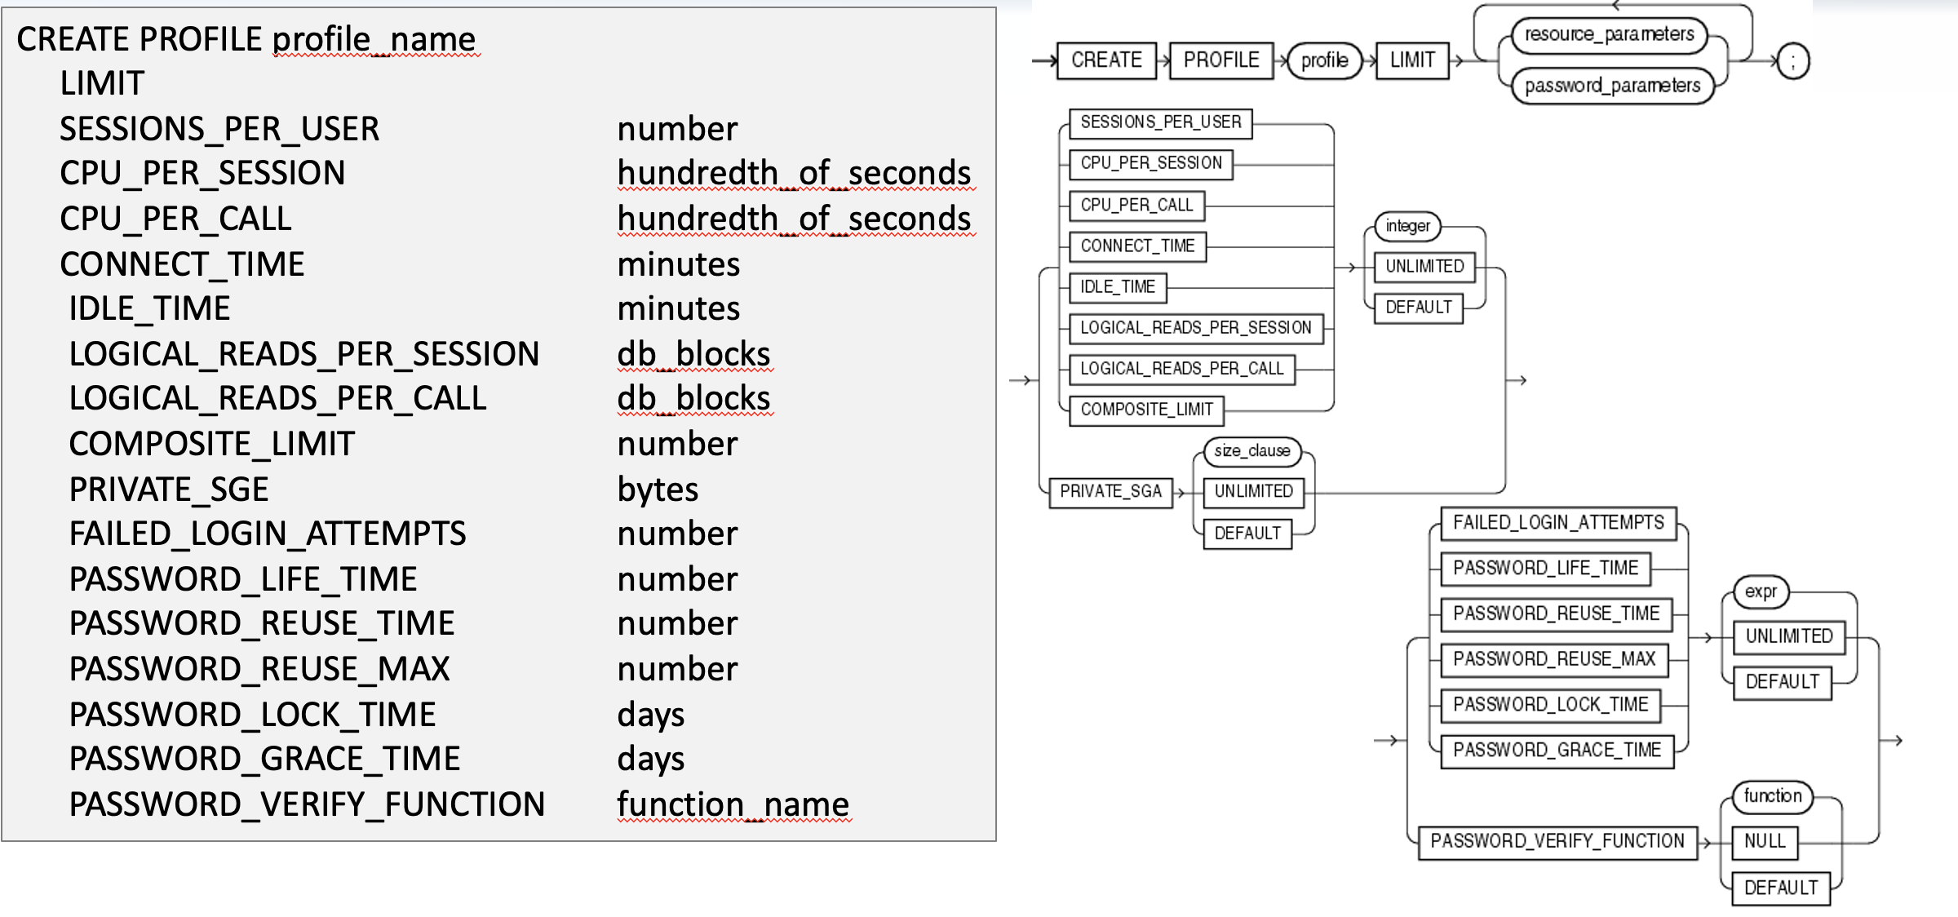
Create Profile

Slide 11
Service Accounts and Secrets
Service Accounts
Systems use service accounts, Users use user accounts
Never mix their use for convenience
Secrets
Humans shouldn’t handle secrets for service accounts
Secrets NEVER go in source control or messages

Slide 12
Authentication Best Practices
User creation policy should be documented with requisite approval process
Multifactor authentication should be used always for user accounts
Mutual authentication should be used always for service accounts

Slide 13
Database Authorization

Slide 14
Simple Clarification
Authentication does not allow a user to connect to a database. The right to connect is usually the first authorization granted to a user

Slide 15
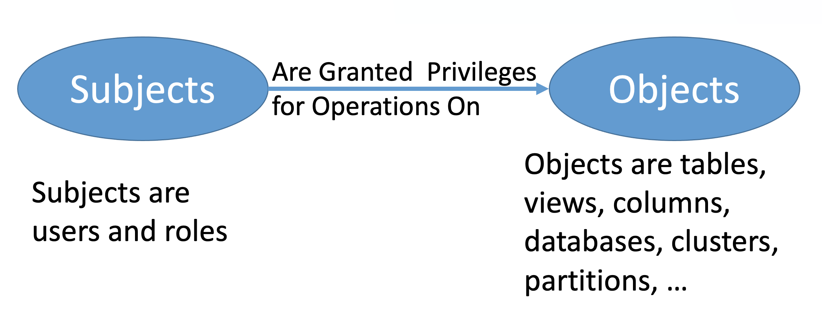
Authorization Policy Concepts
Notes:
Objects are an abstraction

Slide 16
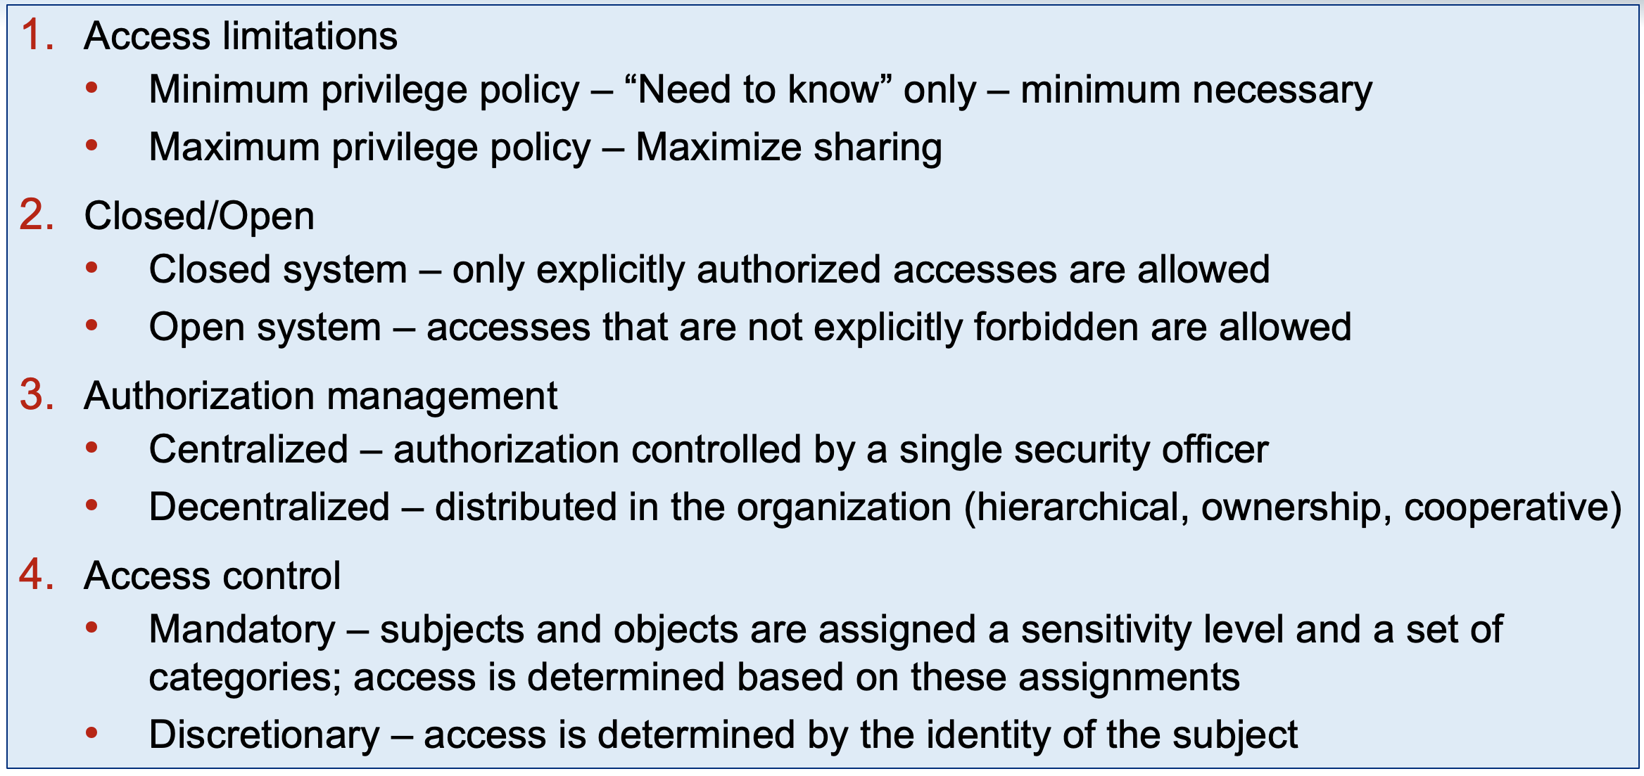
Authorization Policy Concepts

Slide 17
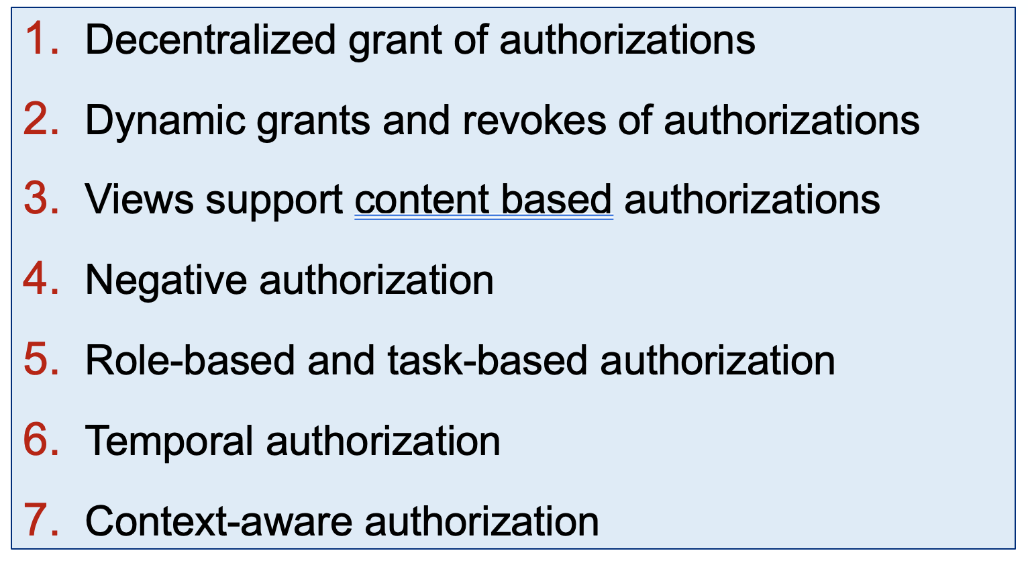
Discretionary Access Control

Slide 18
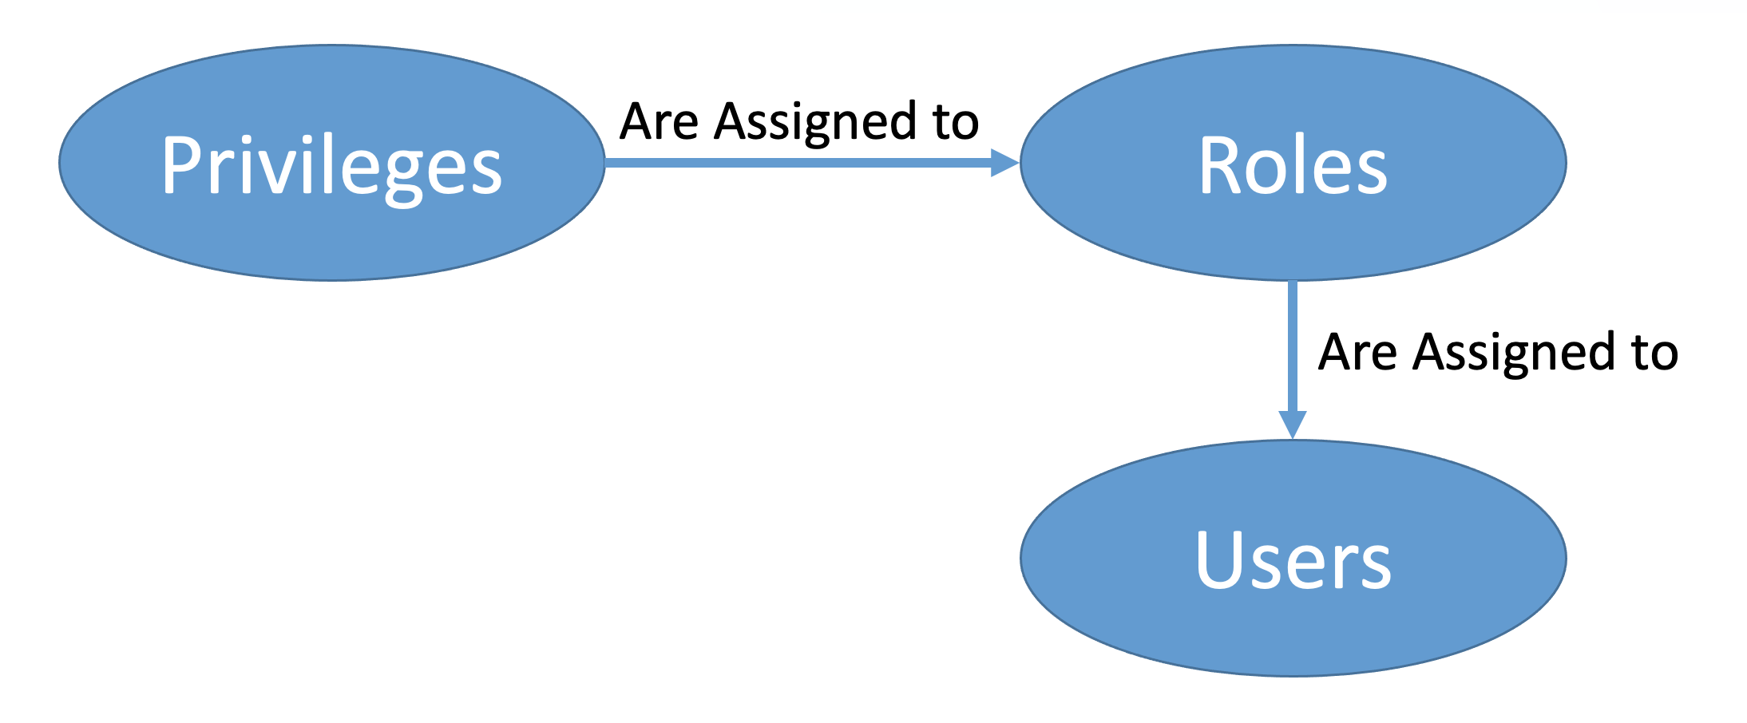
Privileges, Roles, Users - RBAC

Slide 19
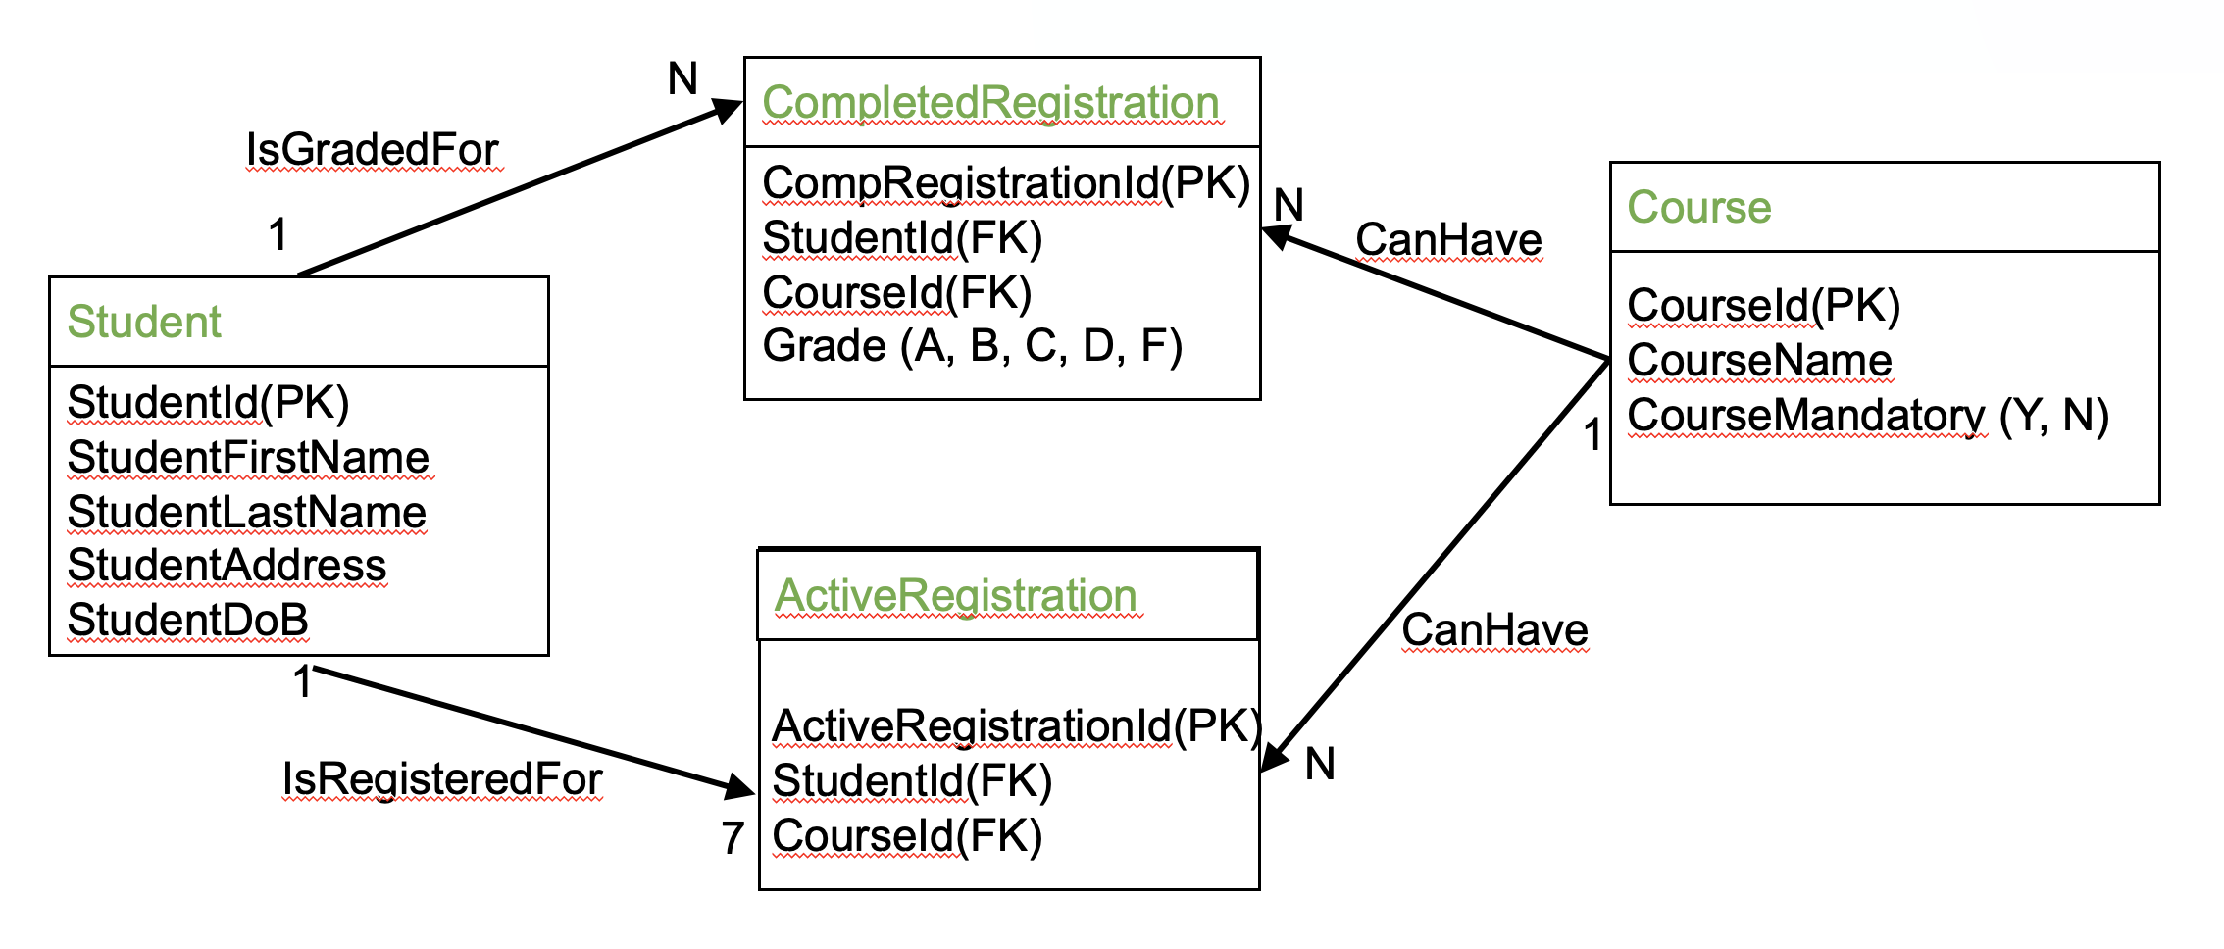
Simple Data Model

Slide 20
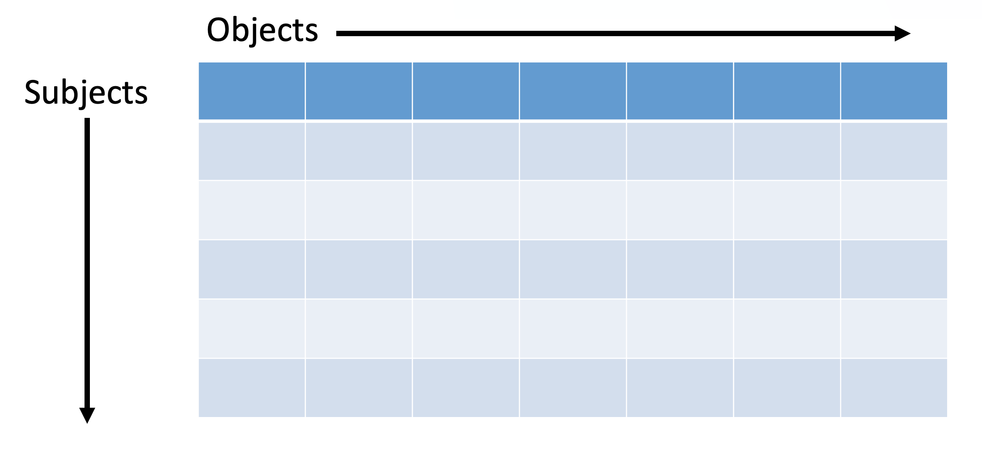
Access Control Matrix

Slide 21
Objects
Subjects
 | Student | Course | Completed Registration | Active Registration
Students
Faculty
Administrators
Table Privileges
Select
Insert
Update
Delete

Slide 22
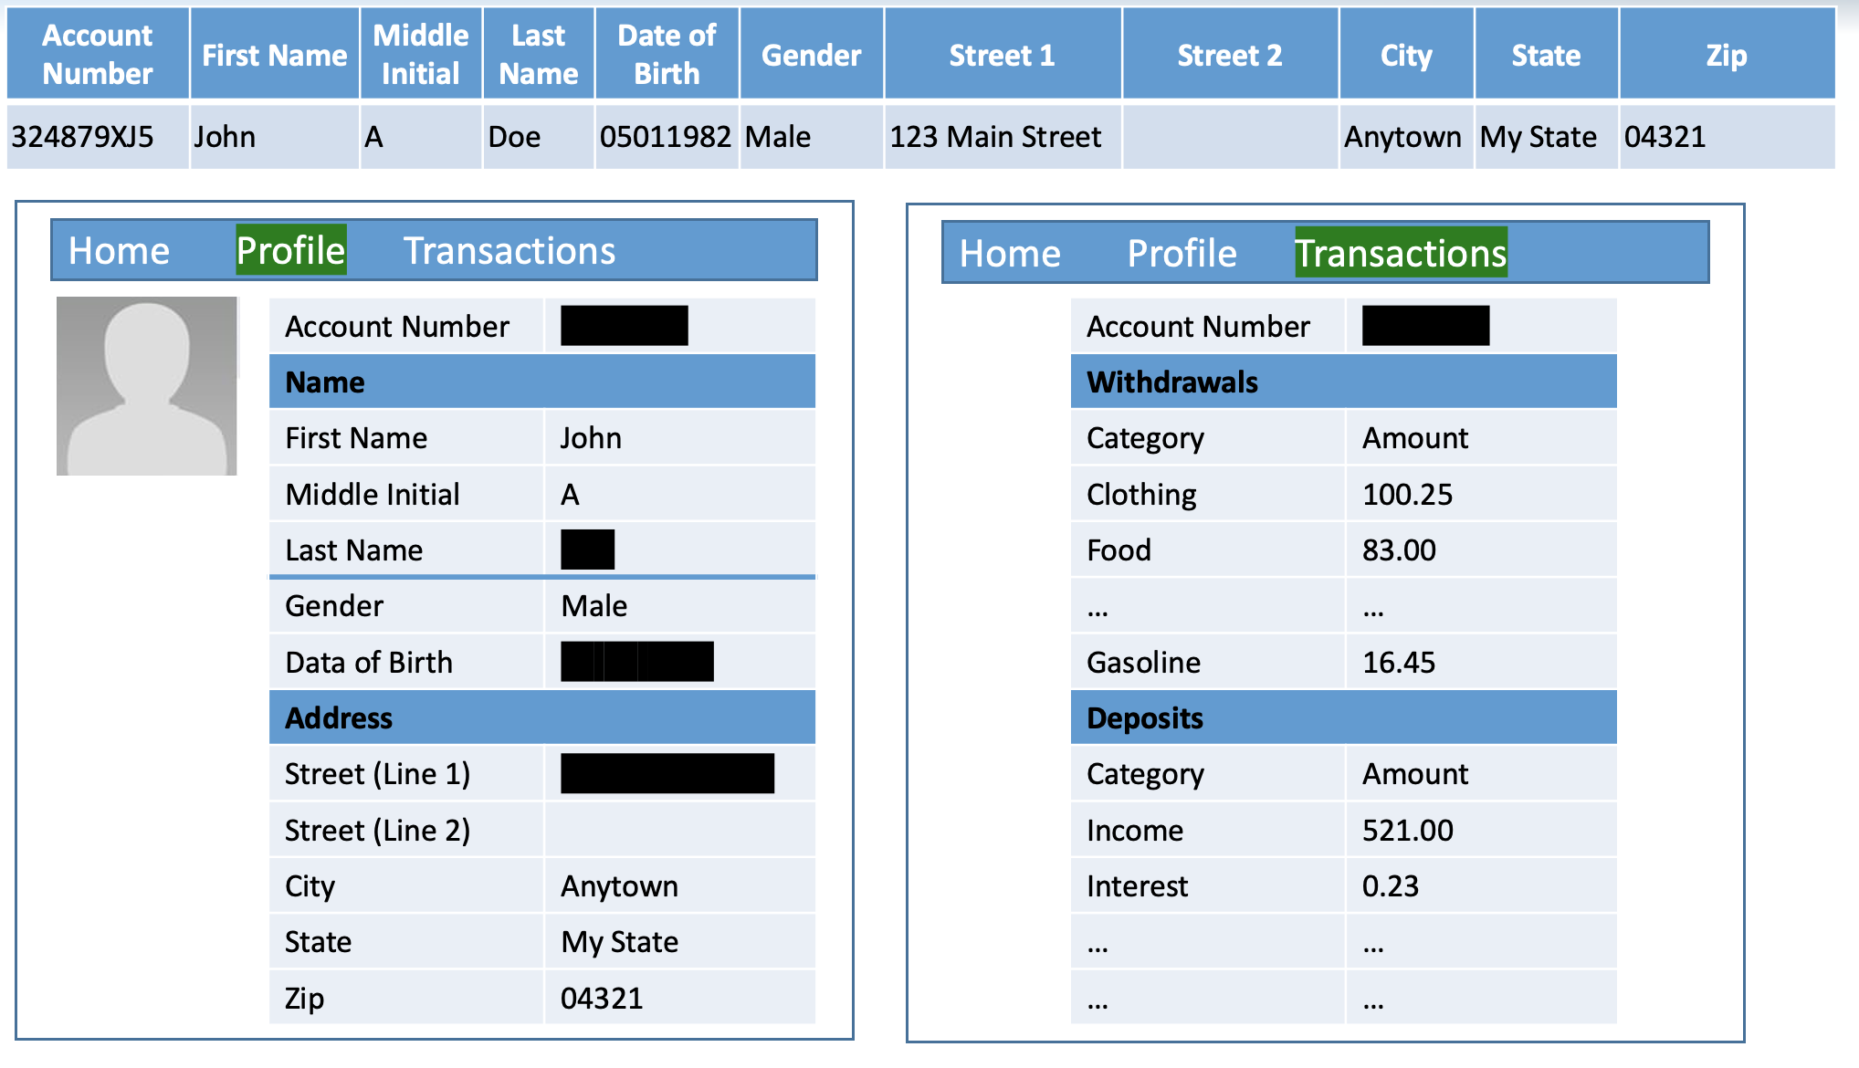
Data Redaction

Slide 23
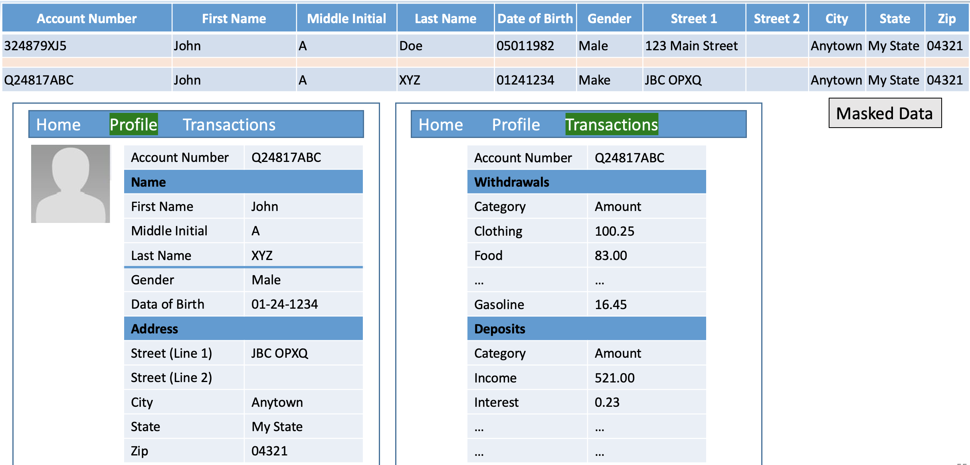
Data Masking

Slide 24
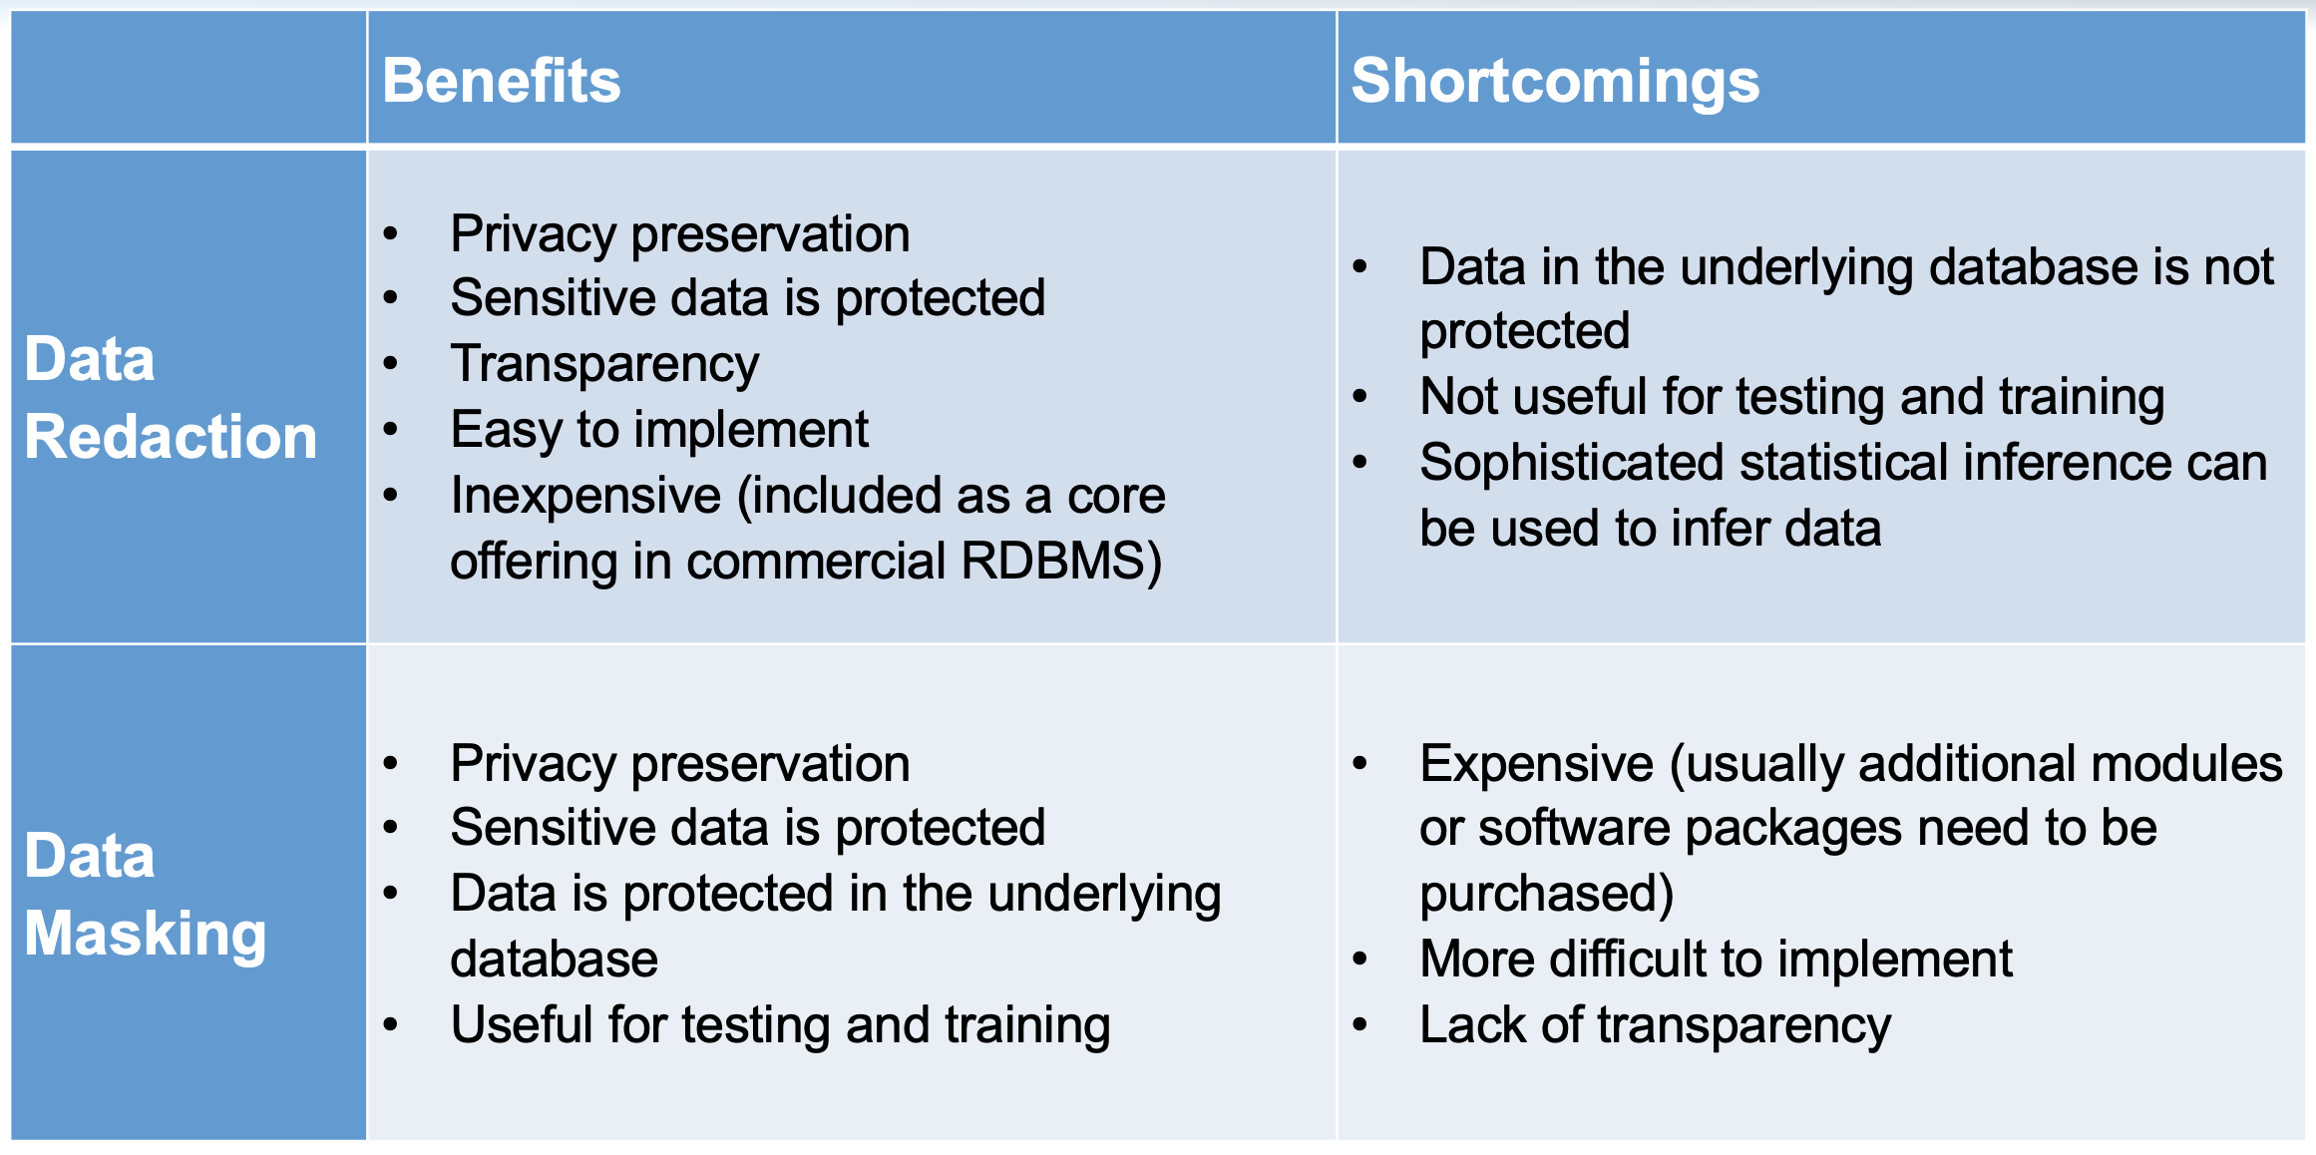
Redaction/Masking

Slide 25
Final Project Survey
We will assign your teams, but want to do so in an informed way
Please quickly complete survey on Canvas
Expires tonight

Slide 26
Next Class
Always on Canvas
Takeaways, Reflections, Questions – Due Sunday night
No other homework assignments
1 reading in preparation for next week
Issues with Relational Databases

